Slide 1

PORT
Computer Information
Special Video
Kim - MinSu
FOLIO

Slide 2

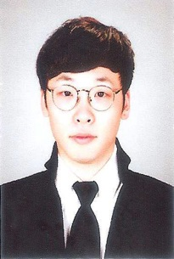
CONTENT
Kim-minsu
010-3229-4657
kok2230@naver.com
PROFILE
EXPERIENCE
LICENSE
RESULT

Slide 3











ADDRESS
PROFILE
Yunju 1-story, Yangji 6-gil, Nam-gu, Daegu, Korea
EDUCATION
SKILL
Shim In Middle School
2007.03 ~ 2010.02
Daegu Technical High School
2010.03 ~ 2013.02
Yeung Jin College
2013.03 ~ 2018.02

Slide 4

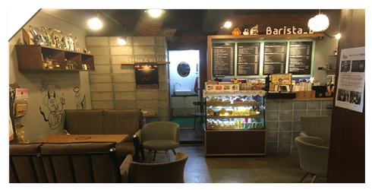
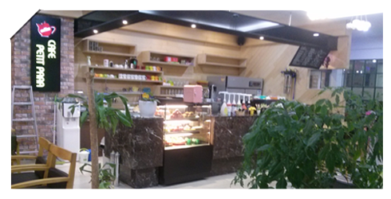

EXPERIENCE
WORKING PERIOD
PARTTIME JOB - CAFE
2YEARS 6 MONTHS
PARTTIME JOB - CAFE
6 MONTHS
INTERN
1 MONTHS

Slide 5
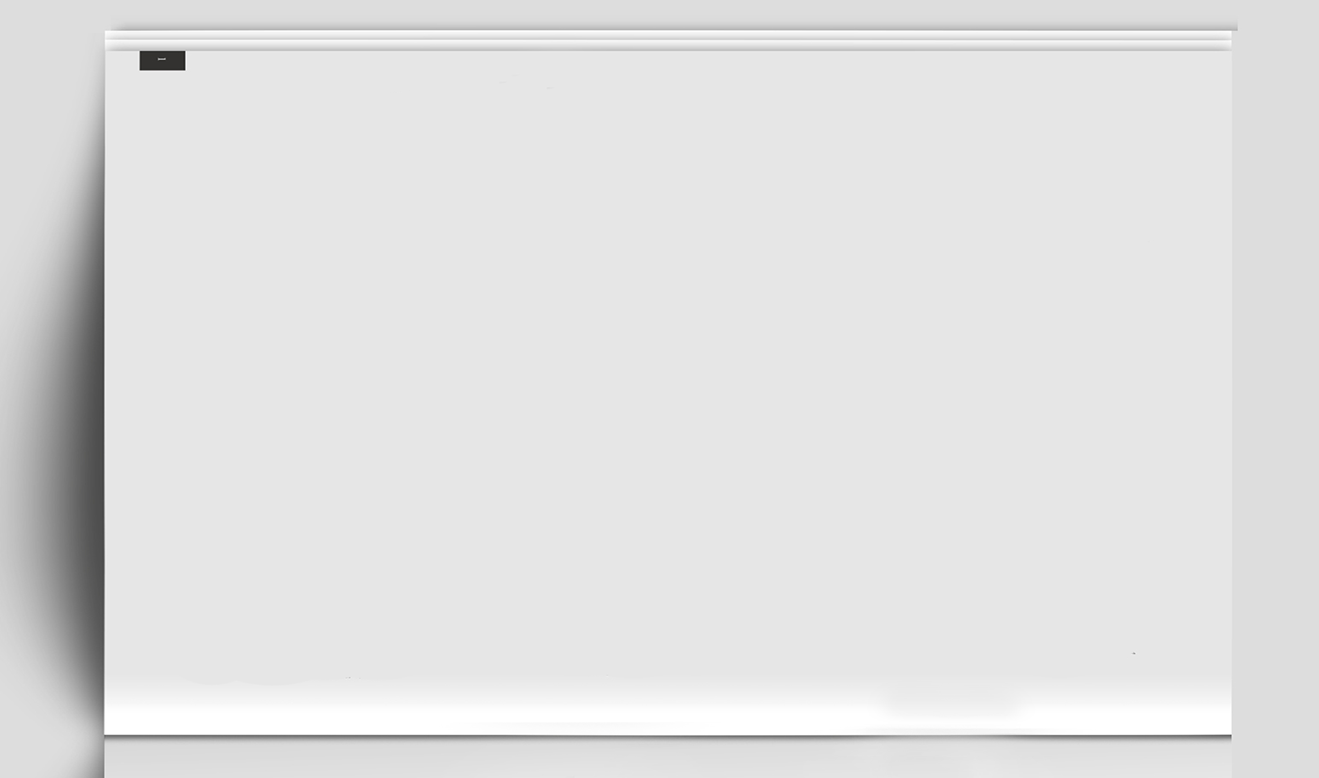
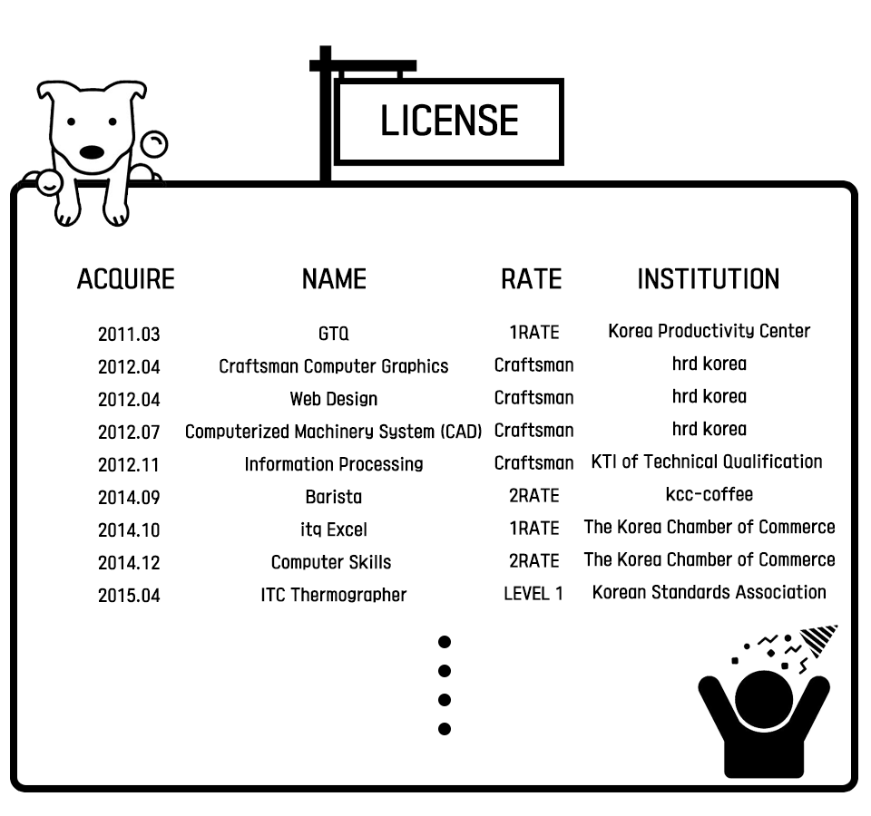
LICENSE
STUDYING
Industrial Engineer
Information Processing

Slide 6

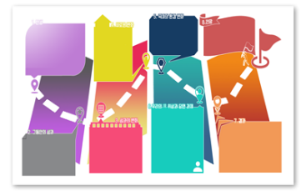



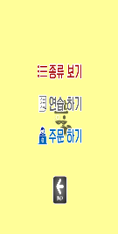

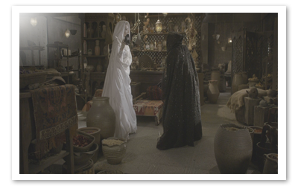
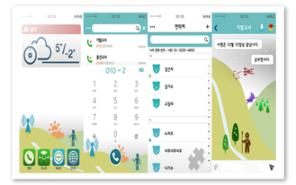
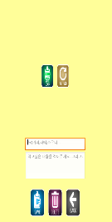
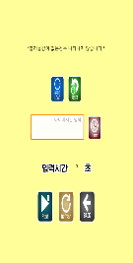

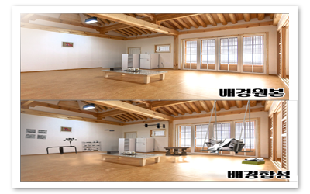
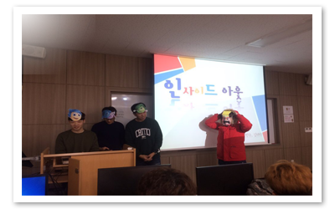
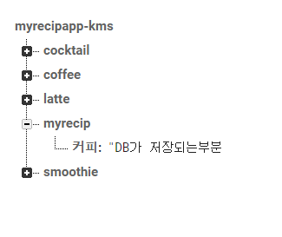
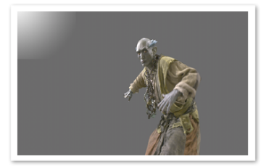
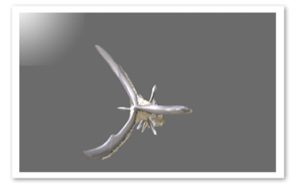

RESULT
CAPSTONE DSIGN
POSTER
IN
APP IMG
DATA BASE

Slide 7

THANK
YOU

